Slide 1
CCE201: Solid State Electronic Devices
EEC223: Electronics (1)
Lecture 07
Bipolar Junction Transistors (2)
Prepared By
Dr. Eng. Sherif Hekal
Assistant Professor, CCE department

Slide 2
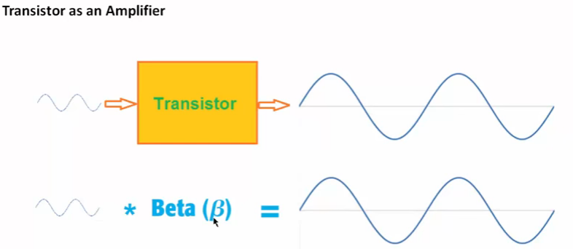
Applying the BJT in Amplifier Design

Slide 3
Applying the BJT in Amplifier Design
an amplifier may be designed by transistor and series of resistances.
However, it is necessary to model the voltage transfer characteristic (VTC).
Appropriate biasing is important to ensure linear gain, and appropriate input voltage swing.
Notes:
The basis for this important application is that when operated in the active mode, the BJT functions as a voltage-controlled current source: the base–emitter voltage controls the collector current. Although the control relationship is nonlinear (exponential), we will shortly devise a method for obtaining almost-linear amplification from this fundamentally nonlinear device.

Slide 4
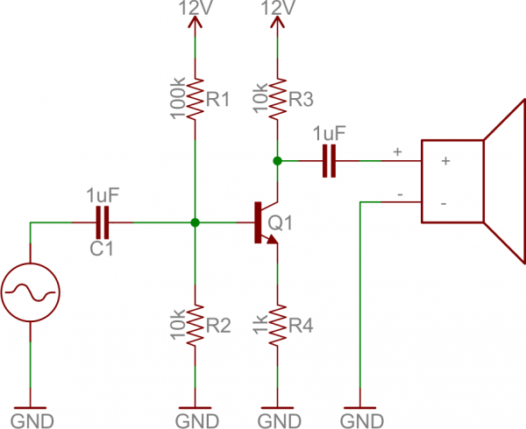
Applying the BJT in Amplifier Design

Slide 5

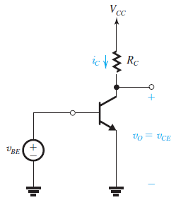
Obtaining a Voltage Amplifier
The BJT is a voltage-controlled current source that can serve as a transconductance amplifier.
A simple way to convert a transconductance amplifier to a voltage amplifier is to pass the output current through a resistor and take the voltage across the resistor as the output.
The output voltage is given by
Thus it is an inverted version (note the minus sign) of i_{C}R_{C} that is shifted by the constant value of the supply voltage which will be removed by a coupling capacitor
Notes:
the output voltage is taken between the collector and ground, rather than simply across RC. This is done because of the need to maintain a ground reference throughout the circuit.

Slide 6
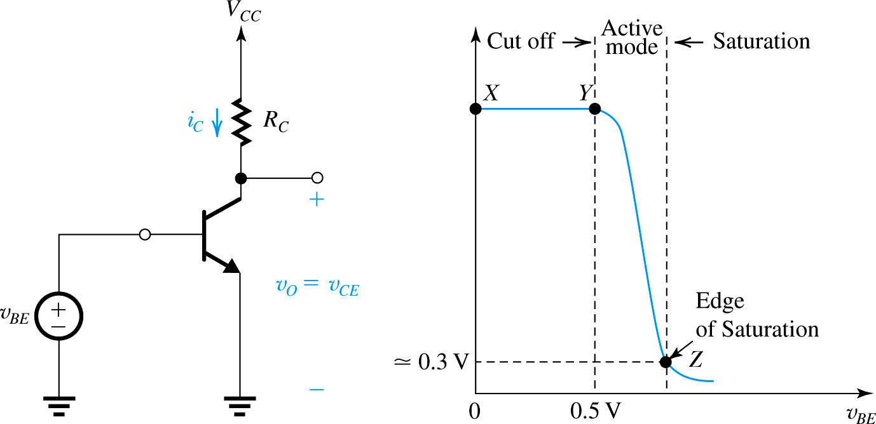
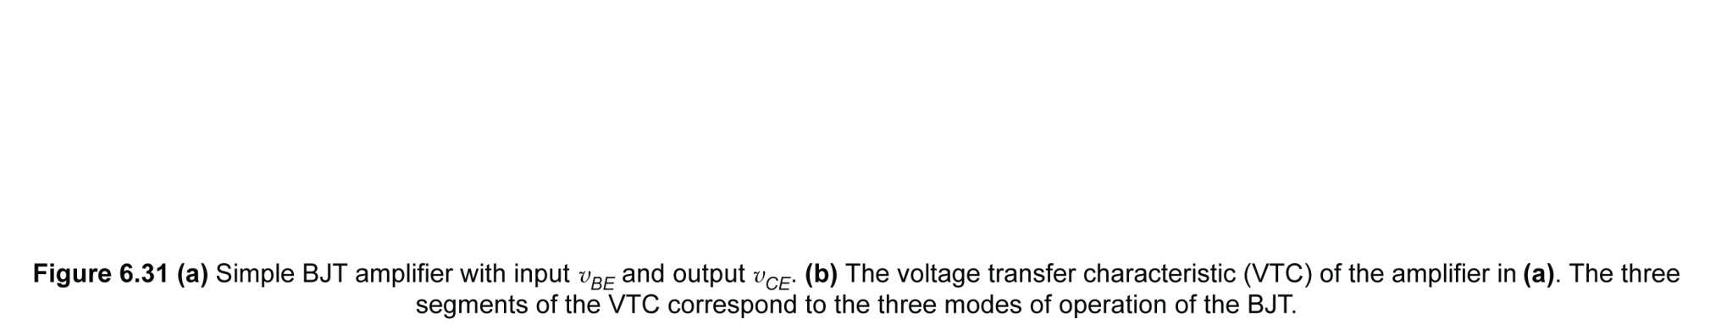
The Voltage Transfer Characteristic (VTC)
7.1
Notes:
A simple way to convert a transconductance amplifier to a voltage amplifier is to pass the output current through a resistor and take the voltage across the resistor as the output.

Slide 7

The Voltage Transfer Characteristic (VTC)
A very useful tool that yields great insight into the operation of an amplifier circuit is its voltage transfer characteristic (VTC).
The VTC in Fig. 7.1 (b) indicates that the segment of greatest slope (and hence potentially the largest amplifier gain) is that labeled YZ,
An expression for the segment YZ can be obtained by
This is obviously a nonlinear relationship. Nevertheless, linear amplification can be obtained by using the technique of biasing the BJT.

Slide 8
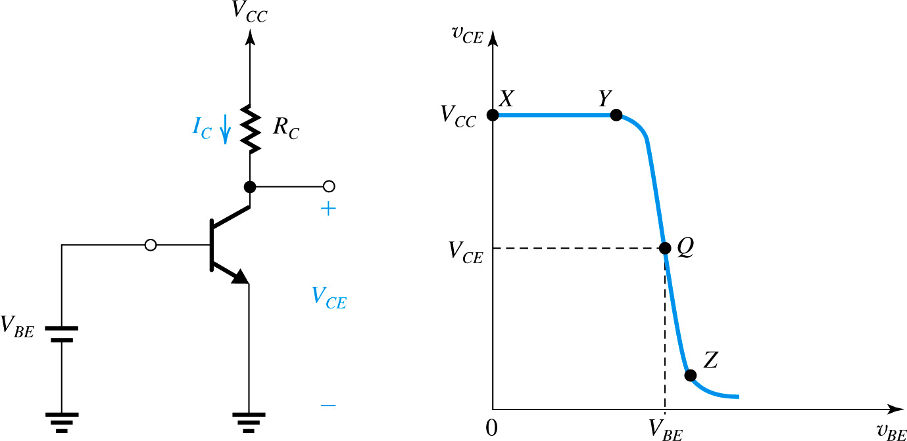
Biasing the BJT to Obtain Linear Amplification
Figure 6.32: Biasing the BJT amplifier at a point Q located on the active-mode segment of the VTC.
7.2
Notes:
Biasing enables us to obtain almost-linear amplification from the BJT. The technique is illustrated in Fig. 6.32(a). A dc voltage VBE is selected to obtain operation at a point Q on the segment YZ of the VTC. How to select an appropriate location for the bias point Q will be discussed shortly.

Slide 9
Biasing the BJT to Obtain Linear Amplification
Biasing enables us to obtain almost-linear amplification from the BJT.
A dc voltage V_{BE} is selected to obtain operation at a point Q on the segment YZ of the VTC.
Point Q is known as the bias point or the dc operating point. Also, since at Q no signal component is present, it is also known as the quiescent point.
How to select an appropriate location for the bias point Q will be discussed shortly.

Slide 10
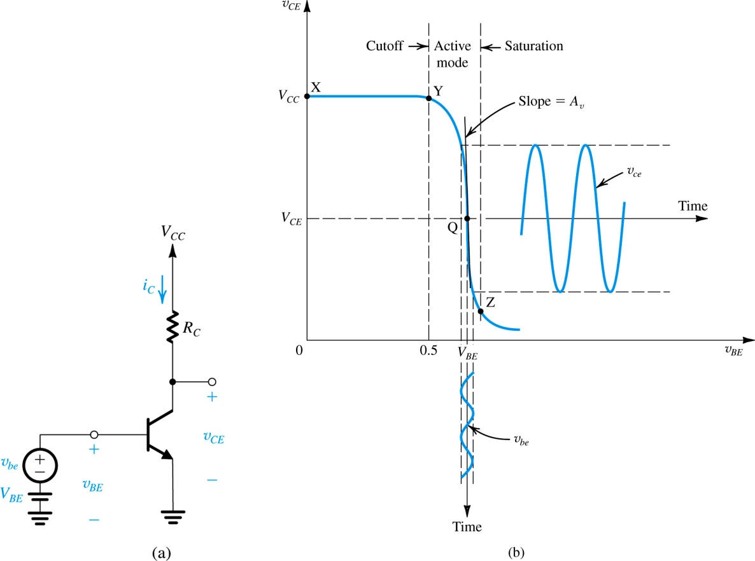
Biasing the BJT to Obtain Linear Amplification
Figure 7.3

Slide 11
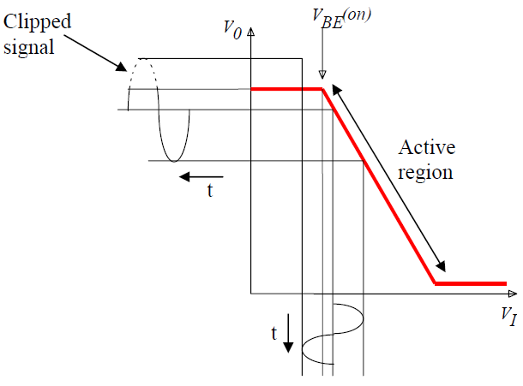
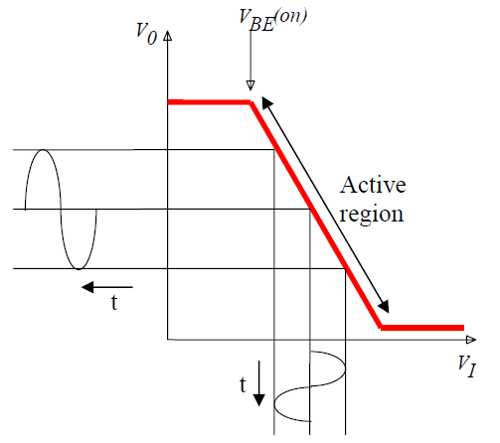
Biasing the BJT to Obtain Linear Amplification
Good Biasing
Bad Biasing

Slide 12


The Small-Signal Voltage Gain
If the input signal v_{be} is kept small, the corresponding signal v_{ce} at the output will be nearly proportional to with the constant of proportionality being the slope of the almost-linear segment of the VTC around Q.

Slide 13
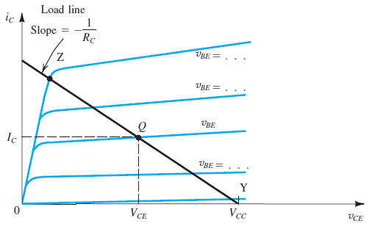
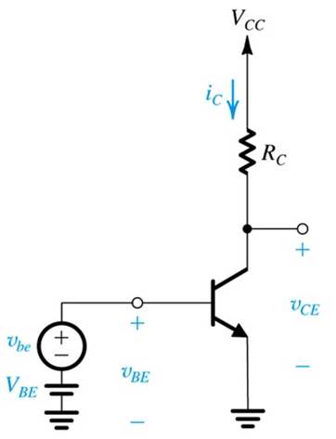

Locating the Bias Point Q
The bias point Q is determined by the value of V_{BE} and that of the load resistance R_{C}.
Notes:
Effect of bias-point location on allowable signal swing: Load line A results in bias point QA with a corresponding VCE that is too close to VCC and thus limits the positive swing of vCE. At the other extreme, load line B results in an operating point, QB, too close to the saturation region, thus limiting the negative swing of vCE.

Slide 14
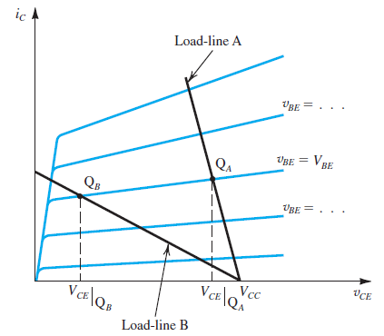
Locating the Bias Point Q
Effect of bias-point location on allowable signal swing:
Load line A results in bias point Q_{A} with a corresponding V_{CE} that is too close to V_{CC} and thus limits the positive swing of v_{CE}.
At the other extreme, load line B results in an operating point, Q_{B}, too close to the saturation region, thus limiting the negative swing of v_{CE}.
Notes:
Effect of bias-point location on allowable signal swing: Load line A results in bias point QA with a corresponding VCE that is too close to VCC and thus limits the positive swing of vCE. At the other extreme, load line B results in an operating point, QB, too close to the saturation region, thus limiting the negative swing of vCE.

Slide 15
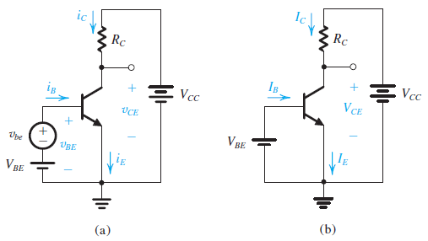
Small-Signal Operation and Models
consider once more the conceptual amplifier circuit shown in Fig below
DC analysis
Notes:
Here the base–emitter junction is forward biased by a dc voltage VBE (battery). The reverse bias of the collector–base junction is established by connecting the collector to another power supply of voltage VCC through a resistor RC.
The input signal to be amplified is represented by the voltage source vbe that is superimposed on VBE.

Slide 16
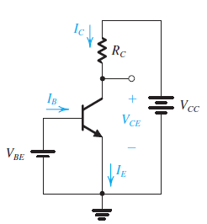


Small-Signal Operation and Models
We consider first the dc bias conditions by setting the signal v_{be} to zero
for active-mode operation, V_{C} should be greater than (V_{B} − 0.4) by an amount that allows for the required signal swing at the collector.

Slide 17
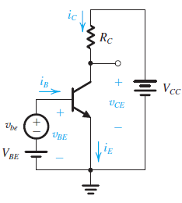







Small-Signal Operation and Models
If a signal v_{be} is applied as shown in Figure, the total instantaneous base–emitter voltage v_{BE} becomes
Now, if v_{be} << V_{T} (peak of v_{be} < 10 mV), we may approximate the above Equation as
where g_{m} is called the transconductance

Slide 18

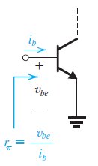





Small-Signal Operation and Models
To determine the resistance seen by v_{be}, we first evaluate the total base current i_{B} using
Substituting for I_{C} ⁄ V_{T} by g_{m} gives
The small-signal input resistance between base and emitter, looking into the base, is denoted by r_{π} and is defined as
Hence,

Slide 19
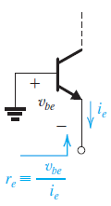





Small-Signal Operation and Models
The total emitter current i_{E} can be determined from
where I_{E} is equal to I_{C} /α and the signal current i_{e} is given by
If we denote the small-signal resistance between base and emitter looking into the emitter by r_{e}, it can be defined as
r_{e} is called the emitter resistance, and given by

Slide 20
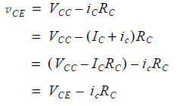



Small-Signal Operation and Models
Voltage Gain
Here the quantity V_{CE} is the dc bias voltage at the collector, and the signal voltage is given by

Slide 21
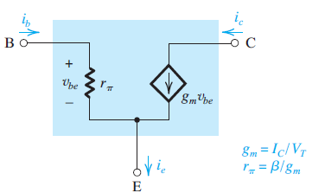
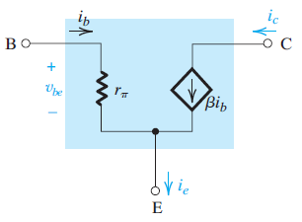
Small-Signal Operation and Models
The Hybrid-π Model
(a)
(b)
the hybrid-π model for the small-signal operation of the BJT. The equivalent circuit in (a) represents the BJT as a voltage-controlled current source (a transconductance amplifier), and that in (b) represents the BJT as a current-controlled current source (a current amplifier).

Slide 22
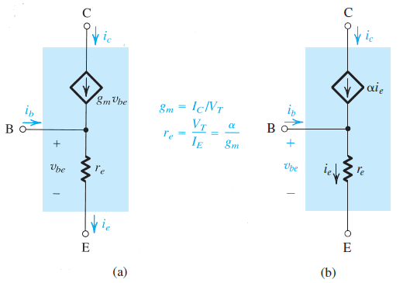
Small-Signal Operation and Models
The T model
T model of the BJT. The circuit in (a) is a voltage-controlled current source representation and that in (b) is a current-controlled current source representation.

Slide 23

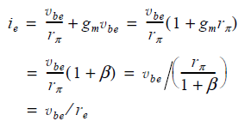
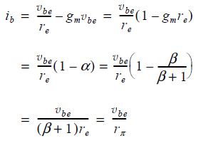
Small-Signal Operation and Models
The relationship between r_{π} and r_{e}
Check compatibility of the two models
The Hybrid-π Model
The T model

Slide 24

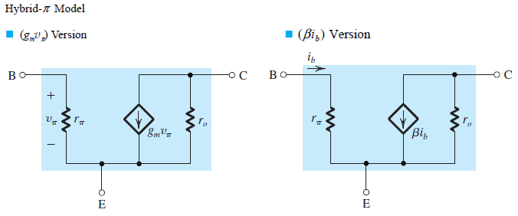
Small-Signal Models of the BJT
Augmenting the Small-Signal Models to Account for the Early Effect
Notes:
Thus the gain will be somewhat reduced. Obviously if ro >> RC, the reduction in gain will be
negligible, and one can ignore the effect of ro. In general, in such a configuration ro can be
neglected if it is greater than 10RC.

Slide 25
Application of the Small-Signal Equivalent Circuits
Analysis of transistor amplifier circuits is a systematic process. The process consists of the following steps:
Eliminate the signal source and determine the dc operating point of the BJT and in particular the dc collector current I_{C}.
Calculate the values of the small-signal model parameters: g_{m} = I_{C} ⁄ V_{T}, r_{π} = β ⁄ g_{m}, and r_{e} = V_{T} ⁄ I_{E} = α ⁄ g_{m}.
Eliminate the dc sources by replacing each dc voltage source with a short circuit and each dc current source with an open circuit.
Replace the BJT with one of its small-signal equivalent circuit models. Although any one of the models can be used, one might be more convenient than the others for the particular circuit being analyzed. This point will be made clearer later in this chapter.
Analyze the resulting circuit to determine the required quantities (e.g., voltage gain, input resistance).

Slide 26
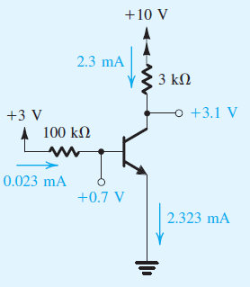
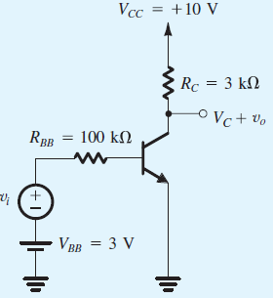
Example 7.1
We wish to analyze the transistor amplifier, shown in the figure below, to determine its voltage gain v_{o} ⁄ v_{i}. Assume β = 100.
DC analysis
V_{ac} ➔ S.C
A_{ac} ➔ O.C
L ➔ S.C
C ➔ O.C

Slide 27
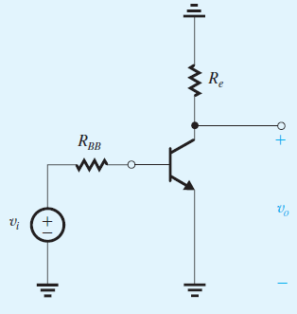
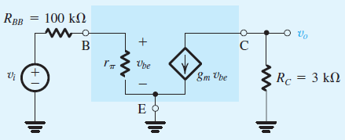
Example 7.1
AC analysis
V_{dc} ➔ S.C
A_{dc} ➔ O.C
L ➔ O.C
C ➔ S.C
Modeling

Slide 28
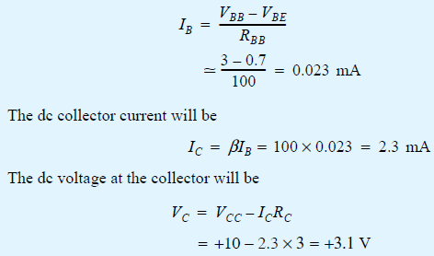
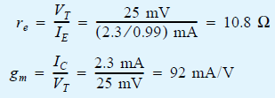
Example 7.1
The first step in the analysis consists of determining the quiescent operating point.
Having determined the operating point, we can now proceed to determine the small-signal model parameters:

Slide 29

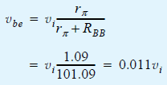


Example 7.1
Analysis of the equivalent circuit model:
Thus the voltage gain will be

Slide 30



Example 7.2
In Example 7.1, assume that v_{i} has a triangular waveform. First determine the maximum amplitude that v_{i} is allowed to have. Then, with the amplitude of v_{i} set to this value,
give the waveforms of the total quantities i_{B}(t), v_{BE}(t), i_{C}(t), and v_{C}(t).
Solution:
To satisfy small-signal approximation, v_{be} should not exceed about 10 mV peak.
Test if you are still in active region with v_{i} = 0.91 V
➔ V_{CB} should be > -0.4 V
The voltage at the collector will consist of a triangular wave v_{o} superimposed on the dc value V_{C} = 3.1 V.

Slide 31
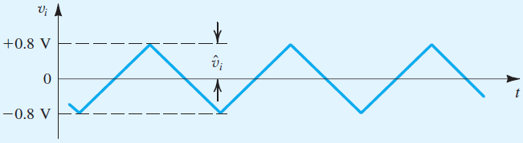
Example 7.2
Maximum available swing at output
V_{CC} > v_{CE} > V_{CE,Sat}
➔ V_{CB} = -0.37V ➔ V_{CB} > -0.4 V
V_{C} reaches a minimum of 3.1 – 2.77 = 0.33 V
to be on the safe side, we will use a somewhat lower value for v_{i} of approximately 0.8 V, as shown in the figure below

Slide 32
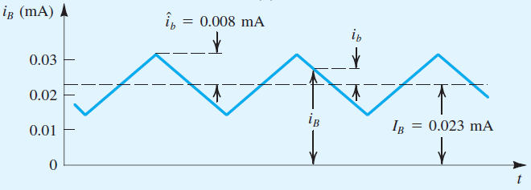

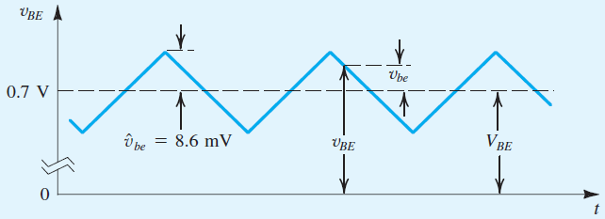

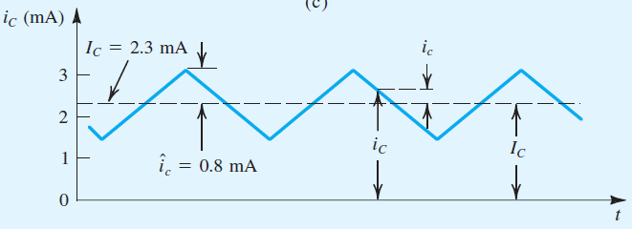

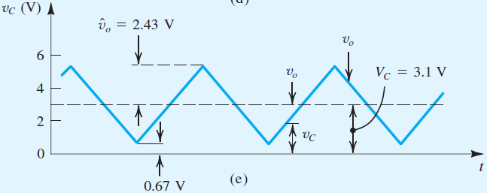

Example 7.2

Slide 33


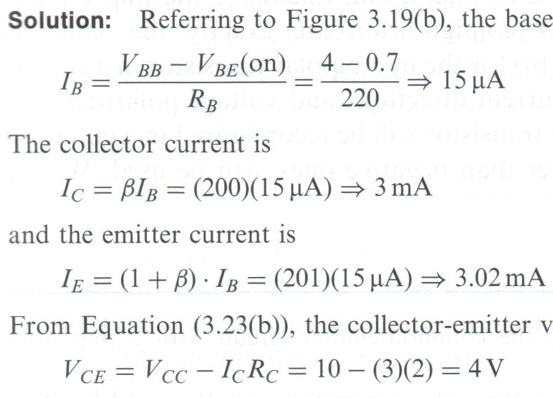

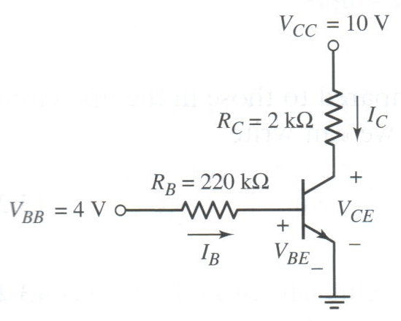
Example 7.3
Calculate the base, collector and emitter currents and the C-E voltage for a common-emitter circuit by considering V_{BB} = 4 V, R_{B} = 220kΩ, R_{C} = 2 kΩ, V_{CC} = 10 V, V_{BE} (on) = 0.7 V and β = 200.

Slide 34
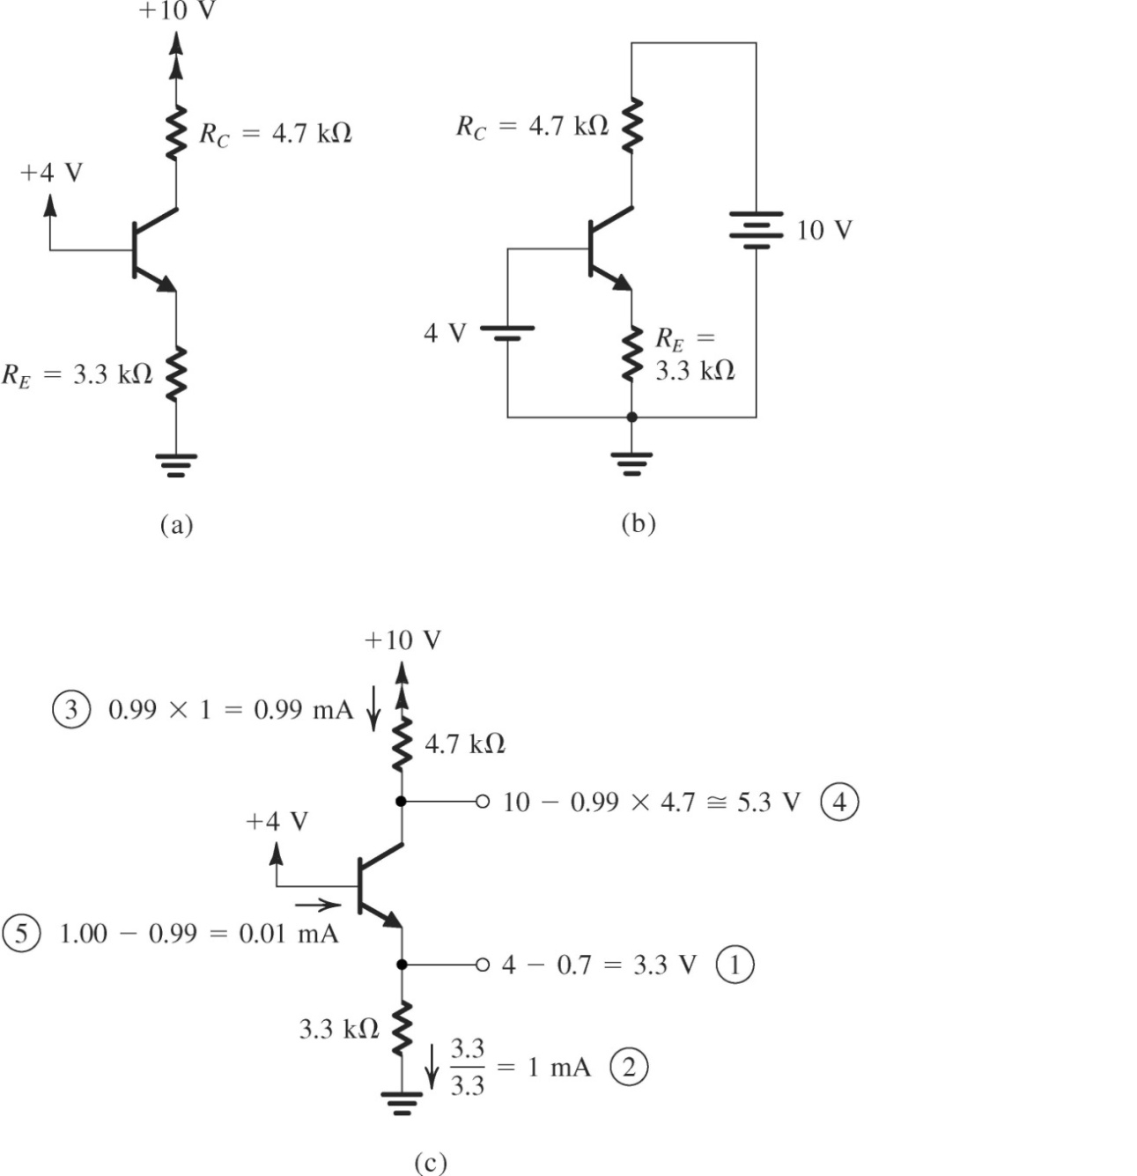
Example 7.4
α = 0.99
KVL at BE loop: 0.7 + I_{E}R_{E} – 4 = 0
I_{E} = 3.3 / 3.3 = 1 mA
Hence, I_{C} = α I_{E} = 0.99 mA
I_{B} = I_{E} – I_{C} = 0.01 mA
KVL at CE loop: I_{C}R_{C} + V_{CE} + I_{E}R_{E} – 10 = 0
V_{CE} = 10 – 3.3 – 4.653 = 2.047 V

Slide 35
Example 7.5
For the circuit shown in Figure, the transistor parameters are β = 100 and VA = ∞. Design the circuit such that ICQ = 0.25 mA and VCEQ = 3 V. Find the small-signal voltage gain Av = vo / vs. Find the input resistance seen by the signal source vs.

Slide 36
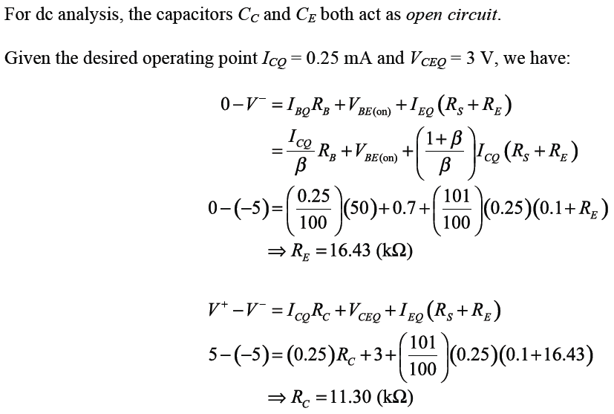
Example 7.5

Slide 37
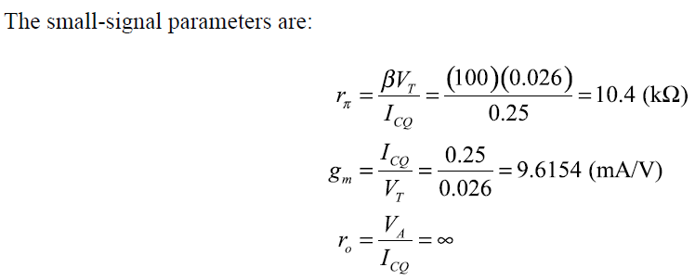
Example 7.5

Slide 38
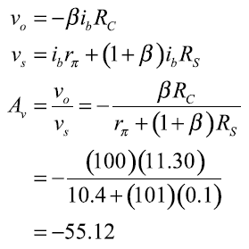
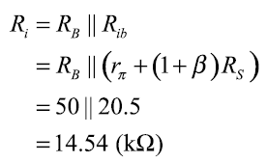
Example 7.5
For small-signal ac analysis, all dc voltages and capacitors act as short circuit. The following expressions are obtained:
The input resistance Ri seen by the signal source vs is:

Slide 39
Example 7.6
Consider the circuit shown in Figure. The transistor parameters are β = 100 and VA = 100 V. Determine Ri, Av = vo / vs and Ai = io / is.

Slide 40
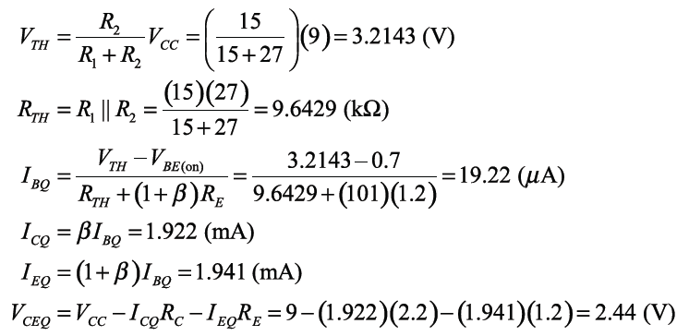
Example 7.6
A dc analysis is performed to determine the dc operating point by treating all capacitors as open circuit.

Slide 41
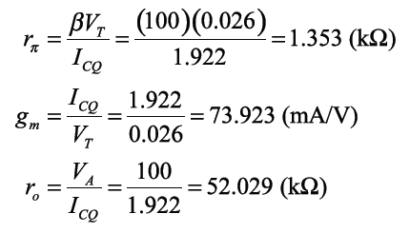
Example 7.6
The small-signal parameters are:

Slide 42
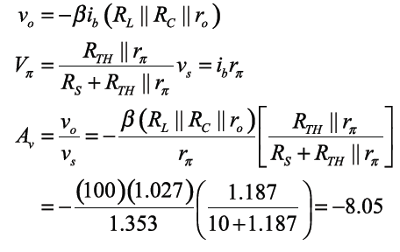
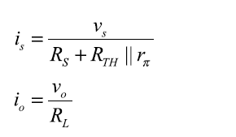
Example 7.6

Slide 43
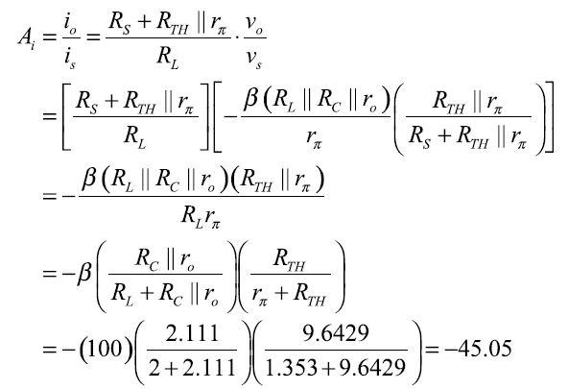

Example 7.6
The input resistance is

Slide 44
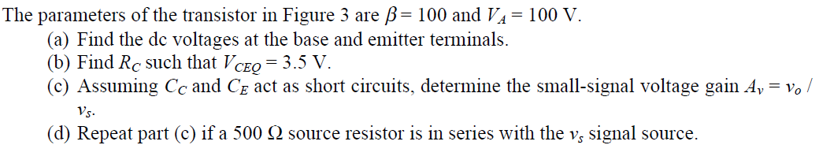
Example 7.7

Slide 45
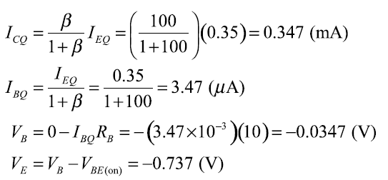
Example 7.7
(a) A dc analysis is performed to determine the dc operating point by treating all capacitors as open circuit.

Slide 46


Example 7.7
(b) Given VCEQ is desired to be 3.5 V, hence:
(c) The small-signal parameters are:

Slide 47

Example 7.7
Using the small-signal ac equivalent circuit, the following expressions are obtained:

Slide 48

Example 7.7
(d) If the source resistor is changed to 500 Ω, the new value of Av is:
Therefore the voltage gain Av decreases as the source resistance RS increases due to a larger voltage drop across the source resistor.

Slide 49

Summary of small signal model parameters

